Slide 1
INFT 5603 Principal of Data Science
Machine learning/Classification Part III
Dr. Tolga Ensari
Department of Engineering and Computing Sciences
Arkansas Tech University
E-mail: tensari@atu.edu

Slide 2
Outline
I. Classification algorithms:
Support Vector Machines (SVM)

Slide 3
Support Vector Machines (SVM)
Support Vector Machines (SVM):
Find a linear hyperplane (decision boundary) that will separate the data.

Slide 4
Support Vector Machines (SVM)
One Possible Solution:

Slide 5
Support Vector Machines (SVM)
Another possible solution:

Slide 6
Support Vector Machines (SVM)
Other possible solutions:

Slide 7
Support Vector Machines (SVM)
Which one is better?
B1 or B2?
How do you define better?

Slide 8
Support Vector Machines (SVM)
Find hyperplane maximizes the margin => B1 is better than B2.

Slide 9
Support Vector Machines (SVM)

Slide 10
Support Vector Machines (SVM)
Linear SVM (Linear model):
Learning the model is equivalent to determining the values of
How to find from training data?

Slide 11

Support Vector Machines (SVM)
Learning Linear SVM:
Objective is to maximize:
Which is equivalent to minimizing:
Subject to the following constraints:
or
This is a constrained optimization problem
Solve it using Lagrange multiplier method.
$$y_{i}(w•x_{i}+b)≥1, i=1,2,...,N$$

Slide 12
Example of Linear SVM:
Support Vector Machines (SVM)
Support vectors

Slide 13
Support Vector Machines (SVM)
Decision boundary depends only on support vectors
If you have data set with same support vectors, decision boundary will not change
How to classify using SVM once w and b are found? Given a test record, x_{i}

Slide 14
Support Vector Machines (SVM)
What if the problem is not linearly separable?

Slide 15
Support Vector Machines (SVM)
What if the problem is not linearly separable?
Introduce slack variables
Need to minimize:
Subject to:
If k is 1 or 2, this leads to similar objective function as linear SVM but with different constraints.

Slide 16
Support Vector Machines (SVM)
Find the hyperplane that optimizes both factors.

Slide 17
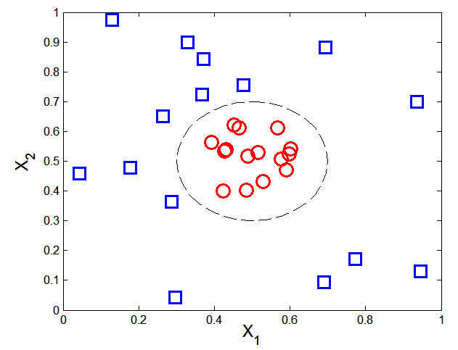

Support Vector Machines (SVM)
What if decision boundary is not linear? → Nonlinear SVM

Slide 18
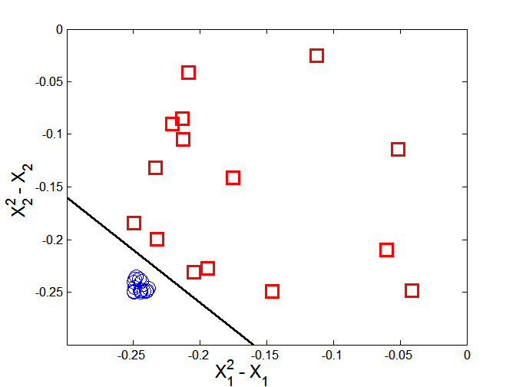



Support Vector Machines (SVM)
Transform data into higher dimensional space
Decision boundary:

Slide 19

Support Vector Machines (SVM)
Learning Nonlinear SVM:
Kernel Trick:
Φ(x_{i})• Φ(x_{j}) = K(x_{i}, x_{j})
K(x_{i}, x_{j}) is a kernel function (expressed in terms of the coordinates in the original space)
Example Kernel functions:

Slide 20
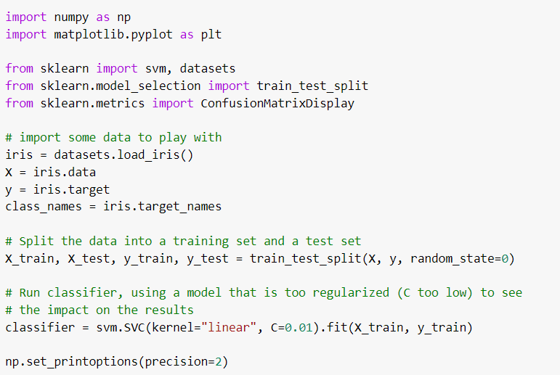
Support Vector Machines (SVM)
Example: Implement the support vector machine (SVM) method to the Iris data set in
Python. Also, show the confusion matrix and normalized confusion matrix.

Slide 21
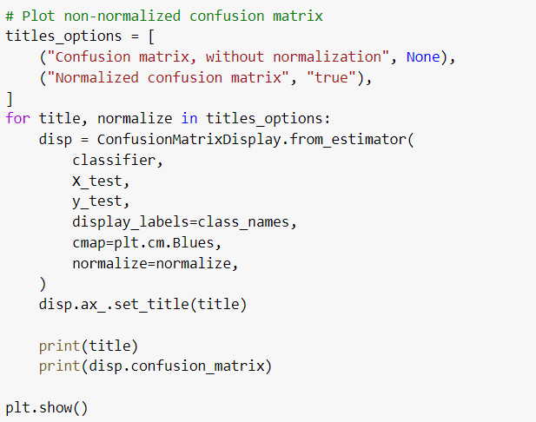
Support Vector Machines (SVM)
(Cont.) Output:

Slide 22
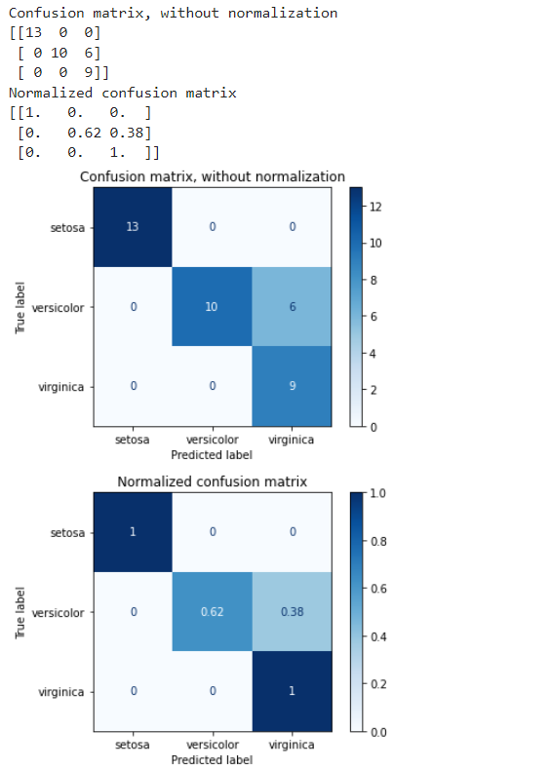
Support Vector Machines (SVM)
(Cont.) Output:

